Slide 1

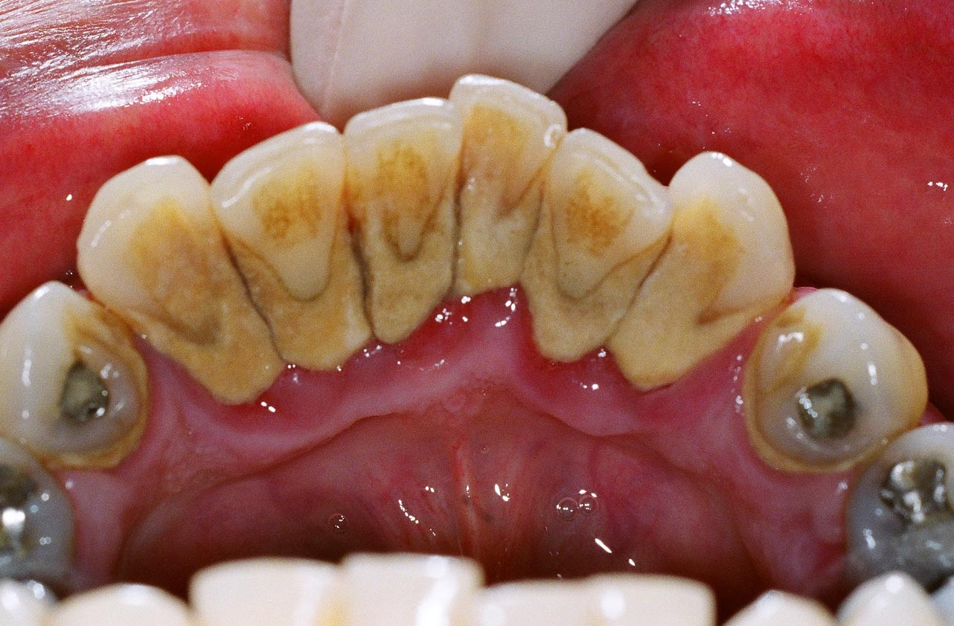
RUNGTA COLLEGE OF DENTAL SCIENCES AND RESEARCH,BHILAI
DENTAL CALCULUS
Dr PushpendraYadav
Sr. lecturer
Dept of Periodontology

Slide 2
SPECIFIC LEARNING OBJECTIVES
CORE AREAS | DOMAIN | CATEGORY
INTRODUCTION | Affective | Desire to know
DEFINITION | Cognitive | Must to know
CLASSIFICATION | Cognitive | Must to know
COMPOSITION | Cognitive | Must to know
FORMATION | Cognitive | Must to know
THEORIES | Cognitive | Must to know
ETIOLOGIC SIGNIFICANCE | Cognitive | Must to know
MATERIA ALBA, FOOD DEBRIS, AND DENTAL STAINS | Cognitive | Must to know
Other predisposing factors | Cognitive | Must to know
FOOD IMPACTION | Cognitive | Must to know
MATERIALS | Cognitive | Must to know
PARAFUNCTIONAL HABIT | Cognitive | Must to know

Slide 3
CONTENT
PART I
INTRODUCTION
DEFINITION
CLASSIFICATION
COMPOSITION
FORMATION
PART II
THEORIES
ETIOLOGIC SIGNIFICANCE
MATERIA ALBA, FOOD DEBRIS, AND DENTAL STAINS
OTHER PREDISPOSING FACTORS
FOOD IMPACTION
MATERIALS
PARAFUNCTIONAL HABIT
SUMMARY
REFERENCE

Slide 4
Theories on Mineralization of Calculus
1. Mineral precipitation
2. Epitactic concept

Slide 5
Mineral precipitation results from a local rise in the degree of saturation of calcium and phosphate ions, which may occur through the following mechanisms...
An increase in the pH of the saliva
causes precipitation of calcium phosphate salts
The pH may be elevated by the...
loss of carbon dioxide and the formation of ammonia by dental plaque bacteria or by protein degradation during stagnation.
I

Slide 6
Colloidal proteins in saliva bind calcium and phosphate ions
maintain a supersaturated solution with respect to calcium phosphate salts.
With stagnation of saliva,
colloids settle out, and the supersaturated state is no longer maintained,
leading to precipitation of calcium phosphate salts
II

Slide 7
III
Phosphatase liberated from dental plaque, desquamated epithelial cells, or bacteria precipitates
calcium phosphate by hydrolyzing organic phosphates in saliva,
thus increasing the concentration of free phosphate ions.

Slide 8
Esterase may initiate calcification by
hydrolyzing fatty esters into free fatty acids.
The fatty acids form soaps with calcium and magnesium
later converted into the less–soluble calcium phosphate salts.

Slide 9
EPITACTIC CONCEPT, OR HETEROGENEOUS NUCLEATION.
Seeding agents (intercellular matrix of plaque) induce small foci of calcification that enlarge and coalesce to form a calcified mass.

Slide 10
The carbohydrate–protein complexes may initiate calcification
by removing calcium from the saliva (chelation) and binding with it ………
form nuclei
induce subsequent deposition of minerals.

Slide 11
ROLE OF MICROORGANISMS IN THE MINERALIZATION OF CALCULUS
Filamentous organisms, diphtheroids, and Bacterionema and Veillonella species have the ability to form intracellular apatite crystals.
Mineralization spreads until the matrix and the bacteria are calcified.

Slide 12
Etiologic Significance
Calculus is always covered with a nonmineralized layer of plaque.
A positive correlation between the presence of calculus and the prevalence of gingivitis exists, but this correlation is not as great as that between plaque and gingivitis.
The initiation of periodontal disease in young people is closely related to plaque accumulation, whereas calculus accumulation is more prevalent in chronic periodontitis found in older adults.

Slide 13
The incidence of calculus, gingivitis, and periodontal disease increases with age.
Calculus does not contribute directly to gingival inflammation, but it provides a fixed nidus for the continued accumulation of bacterial plaque and its retention in close proximity to the gingiva.

Slide 14
Subgingival calculus is likely to be the product rather than the cause of periodontal pockets
Plaque initiates gingival inflammation,
which leads to pocket formation,
and the pocket in turn provides a sheltered area for plaque and bacterial accumulation.
The increased flow of gingival crevicular fluid associated with gingival inflammation provides the minerals that mineralize the continually accumulating plaque, resulting in the formation of subgingival calculus

Slide 15
The removal of subgingival plaque and calculus constitutes the cornerstone of periodontal therapy.
Calculus plays an important role in maintaining and accentuating periodontal disease by keeping plaque in close contact with the gingival tissue and by creating areas where plaque removal is impossible.

Slide 16
MATERIA ALBA, FOOD DEBRIS, AND DENTAL STAINS
Materia alba is an accumulation of microorganisms, desquamated epithelial cells, leukocytes, and a mixture of salivary proteins and lipids, with few or no food particles; it lacks the regular internal pattern observed in plaque.
It is a yellow or grayish-white, soft, sticky deposit, and it is somewhat less adherent than dental plaque.
The irritating effect of materia alba on the gingiva is caused by bacteria and their products.

Slide 17
Food Debris
Most food debris is rapidly liquefied by bacterial enzymes and cleared from the oral cavity by salivary flow and the mechanical action of the tongue, cheeks, and lips.
The rate of clearance from the oral cavity varies with the type of food and the individual.
Aqueous solutions are typically cleared within 15 minutes, whereas sticky foods may adhere for more than 1 hour.
Dental plaque is not a derivative of food debris, and food debris is not an important cause of gingivitis.

Slide 18
Dental stains
Pigmented deposits on the tooth surface are called dental stains.
primarily an esthetic problem and do not cause
inflammation of the gingiva.
The use of tobacco products, coffee, tea, certain mouthrinses, and pigments in foods can contribute to stain formation.

Slide 19
Other predisposing factors
Iatrogenic factors
Margins of restoration
  Contours and open contacts
  Materials
  Design of removable partial dentures
  Restorative dentistry procedures
Malocclusion
Parafunctional habits

Slide 20
Periodontal complications associated with orthodontic therapy
Habits and self-inflicted injuries
  Trauma associated with oral jewelry
  Toothbrush trauma
  Chemical irritation
      Smokeless tobacco
      Radiation therapy

Slide 21
Iatrogenic factors
Inadequate dental procedures that contribute to the deterioration of the periodontal tissues are referred to as iatrogenic factors.
Eg:
  root perforations,
  vertical root fractures, and
  endodontic failures that may necessitate tooth extraction.

Slide 22
MARGINS OF RESTORATIONS
Overhanging margins of dental restorations contribute to the development of periodontal disease by
(1) changing the ecologic balance of the gingival sulcus to an area that favors the growth of disease-associated organisms (predominantly gram-negative anaerobic species) at the expense of the health-associated organisms (predominantly gram-positive facultative species) and
(2) inhibiting the patient’s access to remove accumulated plaque.

Slide 23
Margin placement
Subgingival
increase plaque accumulation, gingival inflammation, and the rate of gingival crevicular fluid flow.
at the level of the gingival crest
induce less severe inflammation
Supragingival
associated with degree of periodontal health similar to that seen with nonrestored interproximal surfaces.

Slide 24
Roughness in the subgingival area is considered to be a major contributing factor to plaque buildup and subsequent gingival inflammation.
The subgingival zone is composed of the margin of the restoration, the luting material, and the prepared and unprepared tooth surfaces.

Slide 25
Sources of marginal roughness include
  grooves and scratches in the surface of acrylic resin, porcelain, or gold restorations;
  separation of the restoration margin and the luting material from the cervical finish line, thereby exposing the rough surface of the prepared tooth;
  dissolution and disintegration of the luting material between the preparation and the restoration, thereby leaving a space;
  inadequate marginal fit of the restoration.

Slide 26
CONTOURS AND OPEN CONTACTS
Overcontoured crowns and restorations tend to accumulate plaque and handicap oral hygiene measures in addition to possibly preventing the self-cleaning mechanisms of the adjacent cheek, lips, and tongue.
Undercontoured crowns do not retain as much plaque as overcontoured crowns.
Restorations that fail to reestablish adequate interproximal embrasure spaces are associated with papillary inflammation.

Slide 28
FOOD IMPACTION
Definition: forceful wedging of food into the periodontium by occlusal forces.
As the teeth wear down, their originally convex proximal surfaces become flattened, and the wedging effect of the opposing cusp is exaggerated.

Slide 29
Cusps that tend to forcibly wedge food into interproximal embrasures are known as PLUNGER CUSPS.
These plunger cusp are usually the functional cusp (i.e. palatal cusp of maxillary teeth and buccal cusp of mandibular teeth) and sometimes palatal incline of maxillary buccal cusp & buccal incline of lingual cusp.

Slide 30
The forceful wedging of food normally is prevented by the:
Integrity and location of proximal contact,
The contour of the marginal ridge and developmental grooves, and
The contour of the facial and the lingual surfaces.

Slide 31
Common areas of food impaction:
1. Vertical impaction
  A. Open contacts
  B. Irregular marginal ridge
  C. Plunger cusp

Slide 32
2. Horizontal (lateral) food impaction

Slide 33
According to Hirschfield (1930) ……Factors Causing Food Impaction
  Class I: Occlusal wear
  Class II: Loss of proximal contact
  Class III: Extrusion beyond the occlusal plane
  Class IV: Congenital morphological abnormality
  Class V: Improperly constructed restorations

Slide 34
Sequele of Food Impaction

Slide 35
Signs & Symptoms:
1. DISCOMFORT
  A. Feeling of pressure
  B. Vague pain
  C. Root caries
2. PERIODONTAL CHANGES
  A. Gingival inflammation-bleeding & foul taste
  B. Gingival recession
  C. Periodontitis
  D. Periodontal abscess formation
  E. Alveolar bone loss - vertical

Slide 36
Materials
Excessive pontic-to-tissue contact, contributes to plaque accumulation that will cause gingival inflammation and possibly the formation of pseudopockets.

Slide 37
Design of removable partial dentures
Partial dentures that are worn during both night and day induce more plaque formation than those worn only during the daytime.

Slide 38
Restorative dentistry procedures
The use of rubber dam clamps, matrix bands, and burs in such a manner as to lacerate the gingiva results in varying degrees of mechanical trauma and inflammation.
forceful packing of a gingival retraction cord into the sulcus

Slide 39
Parafunctional habits
Bruxism…………..grinding of the teeth,
  excessive tooth wear
Clenching………when a person holds the teeth firmly together with significant force
  associated with masticatory system disorders

Slide 40
Periodontal complications associated with orthodontic therapy
Favors plaque retention, by directly injuring the gingiva as a result of
  Overextended bands, and
  by creating excessive forces, unfavorable forces, or both on the tooth and its supporting structures
Increase in Prevotella melaninogenica, Prevotella intermedia, and Actinomyces odontolyticus is seen.

Slide 42
Habits and self-inflicted injuries
Mechanical injury
improper use of a toothbrush,
Chemical injury
topical application of caustic medications such as aspirin or cocaine,
pizza burns
the wedging of toothpicks between the teeth,
the application of fingernail pressure against the gingiva
allergic reactions to toothpaste or chewing gum,
the use of chewing tobacco, and
concentrated mouthrinses.

Slide 43
Radiation therapy
induces an obliterative endarteritis that results in soft tissue ischemia and fibrosis;
irradiated bone becomes hypovascular and hypoxic.
Adverse effects of head and neck radiation therapy include
  dermatitis and mucositis of the irradiated area as well as muscle fibrosis and trismus, which may restrict access to the oral cavity.
  Xerostomia results in greater plaque accumulation and a reduced buffering capacity of saliva

Slide 44
SUMMARY
Calculus can also occur readily in germ free animals. Calculocementum is the calculus embedded deeply in the cementum and which appears morphologically similar to cementum.
Calculus is the most prominent plaque retentive
factor and is a secondary etiologic factor for
periodontitis.

Slide 45
REFERENCE
Newman MG, Takei HH, Klokkevold PR, Carranza FA. Carranza’s clinical periodontology, 10th ed. Saunders Elsevier; 2007.
Lindhe J, Lang NP and Karring T. Clinical Periodontology and Implant Dentistry. 6th ed. Oxford (UK): Blackwell Publishing Ltd.; 2015.
Newman MG, Takei HH, Klokkevold PR, Carranza FA. Carranza’s clinical periodontology, 13th ed. Saunders Elsevier; 2018.

Slide 46
THANK YOU

